Slide 1

ITU-ML5G-PS-015: Network failure detection and root cause analysis in 5GC by NFV-based test environment
Team Kaien
2021-12-01
Team member:
阿部 海燕 Kaien ABE
abe@people.kobe-u.ac.jp
白石 善明 Yoshiaki SHIRAISHI
zenmei@port.kobe-u.ac.jp

Slide 2
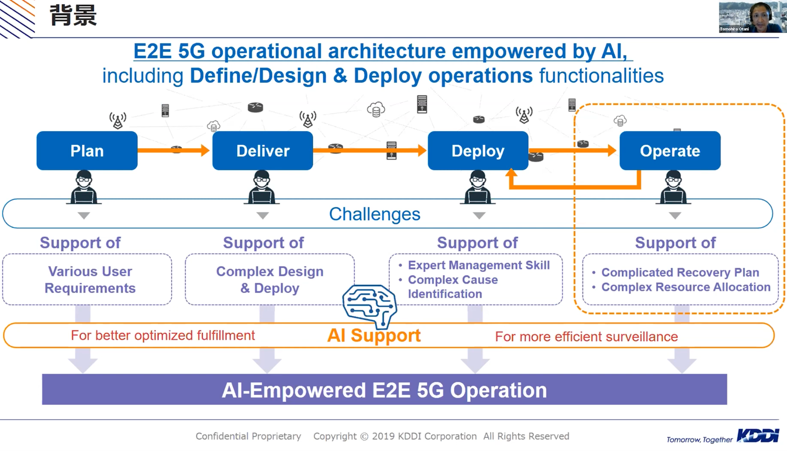
Project Introduction (1)
https://www.youtube.com/watch?v=T18ivePrIUQ

Slide 3
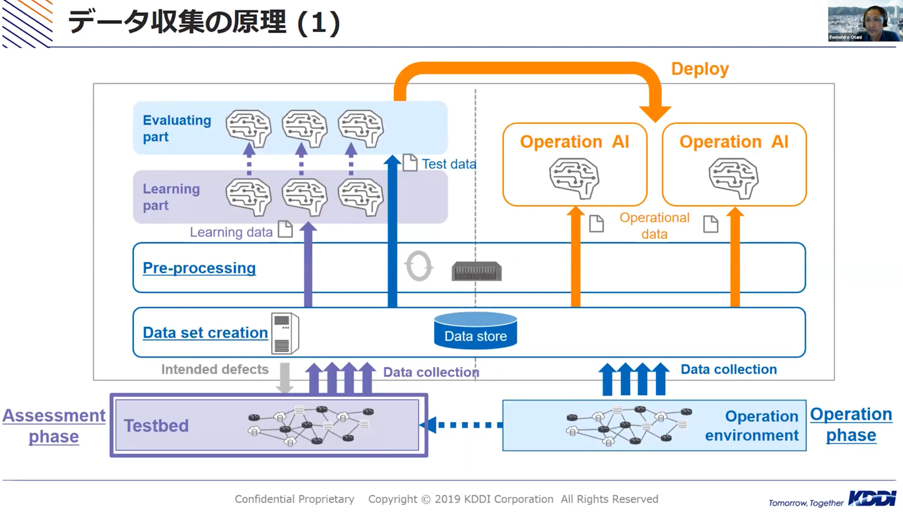
Project Introduction (2)
https://www.youtube.com/watch?v=T18ivePrIUQ

Slide 4
Data processing environment
計算機・ライブラ 環境
Computer configuration
Library
CPU/クロック周波数 | Intel(R) Core(TM) i7-9750H/2.60GHz
メモリー（Memory） | 32GB
OS | Ubuntu 18.04
Anacond3 (Environment) | Python3.8
json (process original json data） | csv (output data format)
Panadas (feature extraction) | sqlite（database for data post-processing
XGBoost (normal model) | XGBoost (increment model)
Original data is 77GB json file, it takes ３ days for feature extraction.
生データ(jsonファイル)は77GB, 特徴量抽出は３日頃かかります.

Slide 5
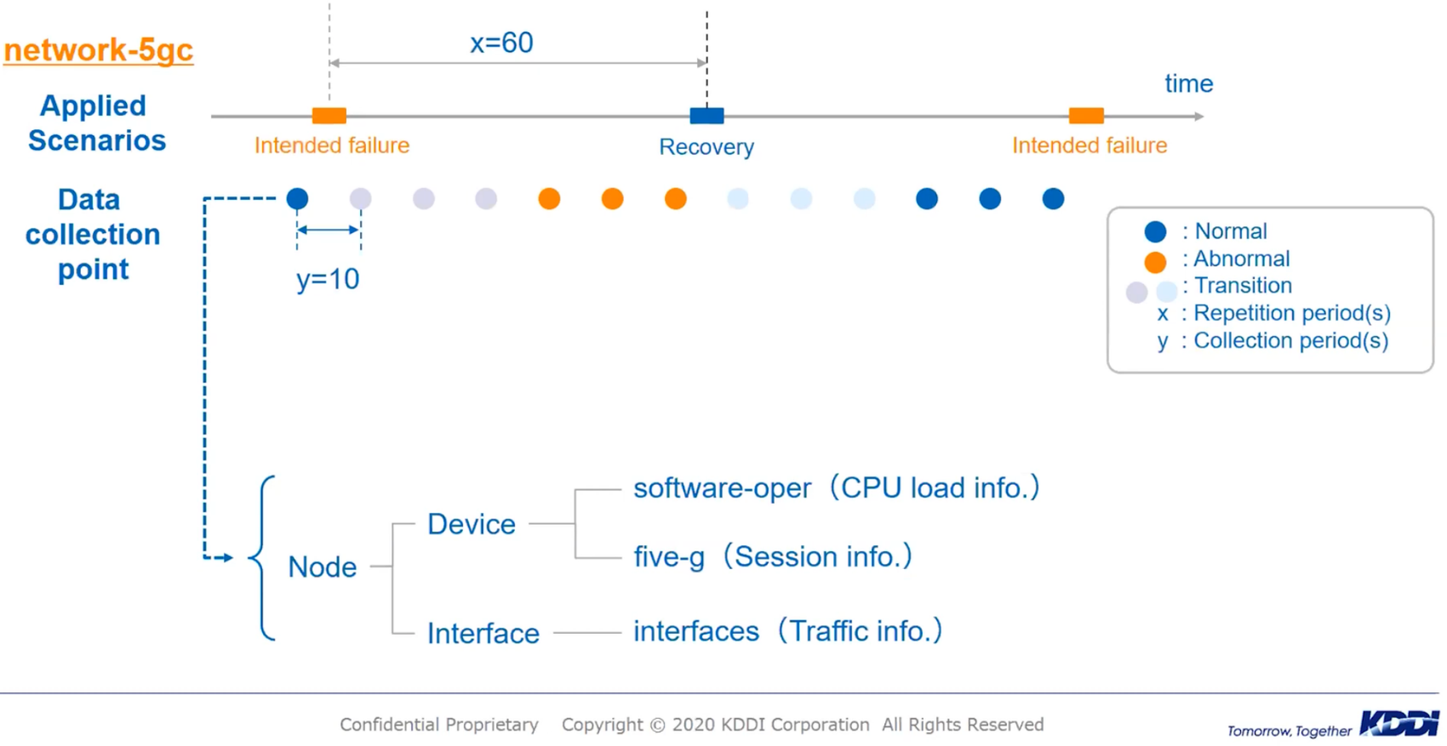
Data investigation
Nodes | Failure
amf | ○ 障害発生
ausf | ○ 障害発生
udm | ○ 障害発生
gnb | × 障害なし
smf | × 障害なし
upf | × 障害なし
nrf | × 障害なし
dn | × 障害なし
8 types nodes are included in the dataset. we found failures are happened in 3 types nodes according to Failure label. In order to reduce calculation cost, only these 3 types nodes are processed. In reality scenario, all of nodes might be be processed.

Slide 6
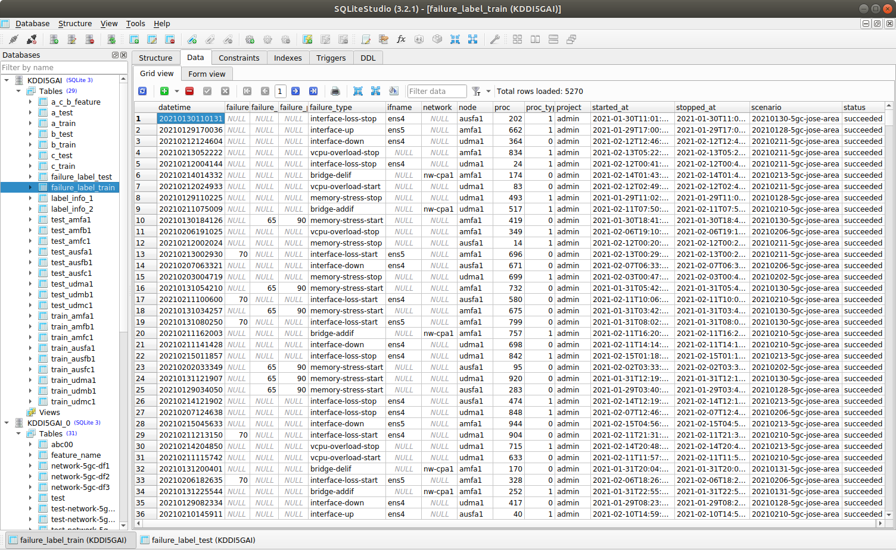
Failure label information
Notes:
Failure parameter loss percent, failure parameter percentage, failure_parameter_stop_second,

Slide 7
Data overview
Provided data: json files (77GB) | a Urban(都市) | c Rural(田舎) | b Middle(中間)
Train | 98,533 | 98,533 | 12,360
Test | 24,647 | 24,647 | 24,647
Failure label | 2480(train)+620(test) | 2480(train)+620(test) | 310(train)+620(test)
Extract features by python code
(One data is split to node data for more precisely label. Here node=3)
Table data of features (103)
Train: (103 features) [nodes: amf, ausf, udm, respectively] | 295,599 (=98,533×3) (×103 特徴量) | 295,599 (=98,533×3) (×103 特徴量) | 37,080 (=12,360×3) (×103 特徴量)
Test: (103 features) [nodes: amf, ausf, udm, respectively] | 73,886 (≒24,647×3) (×103 特徴量) | 73,889 (≒24,647×3) (×103 特徴量) | 73,941 (=24,647×3) (×103 特徴量)
Abnormal data (from failure label) | 4,645 | 4,011 | 1,212
Abnormal /Total (%) | 13% | 10% | 10%

Slide 8
Data processing (1) データ分割のアイデア
障害なし
(No failure)
障害発生
(Failure)
障害なし
(No Failure)
Positive
Data_1 | amf | ausf | udm | Label=1
103 Features
103 Features
103 Features
Data is increased to 3 data
Data_1_amf | amf | Label=0
Data_1_ausf | ausf | Label=1
Data_1_udm | udm | Label=0
103 Features
103 Features
103 Features
障害発生したノートを特定できる
Failure nodes can be located

Slide 9
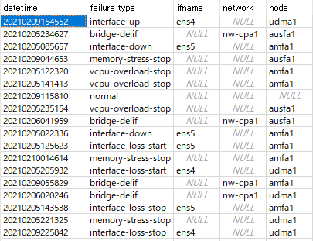
Data processing (2)-how to select features
In the provided dataset, failures happened in three nodes (total nodes=8) so that we only processing 3 nodes information for decreasing data processing work.
Nodes | 障害 | 抽出項目数
特徴量の選抜基準
■Delete category info.
{interface_type,softwareloopback,tunnel,healthy,unknown
interface_name,
interface_if-index,
platform-fru-rp,
phys-address,
Healthy, critical, unknow,up, down,
Null…
}
■All of digital info.
e.g. memory-states,per-core-states,interface-parameter…
■Common features among all of nodes
amf | 障害発生 | 204 (a,c) 154 (b)
ausf | 障害発生 | 175(a,c,b)
udm | 障害発生 | 177(a,c,b)
gnb | 障害なし
smf | 障害なし
upf | 障害なし
nrf | 障害なし
dn | 障害なし
⇒ as features (103)

Slide 10
Data processing (3)- how to label data
正解ラベルの付け方
Form the failure data information (date,time,failure_type,node), we found the following features strongly related to failures, so that we labeled the training and test data according these features. There might be other features also related failures if we carry out furthermore data analysis.
Features 特徴量 | Abnormal 障害あり(label=1) | Normal 障害なし(label=0)
Memory_status： (148)(4512) software-oper_cisco-platform-software_control-processes_control-process_memory-stats_memory-status | 'Critical' 'Warning' | 'Healthy'
Minute_status_condition: 16 software-oper_cisco-platform-software_control-processes_control-process_load-avg-minutes_load-avg-minute_status_condition | 'Critical’ | 'Healthy'
Operation_status: 1(203)2(4996) interfaces_interfaces-state_interface_oper-status | 'down’ (start at, proc) (interface_down) | ‘up’
memory-stats_used-percent： software-oper_cisco-platform-software_control-processes_control-process_memory-stats_used-percent | >90% (memory_stress_stop) | <=90
software-oper_cisco-platform-software_control-processes_control-process_memory-stats_free-percent | <65 (memory_stress_stop) | >=65
software-oper_cisco-platform-software_control-processes_control-process_memory-stats_free-number | <250000 (memory_stress_stop) | >=250000
software-oper_cisco-platform-software_control-processes_control-process_per-core-stats_per-core-stat_idle | 0 (<0.5) (Bridge_delif) | >0.5
software-oper_cisco-platform-software_control-processes_control-process_per-core-stats_per-core-stat_nice | 0 (<0.5) (vcpu_overload_stop) | >0.5
label
Verify by some features

Slide 11
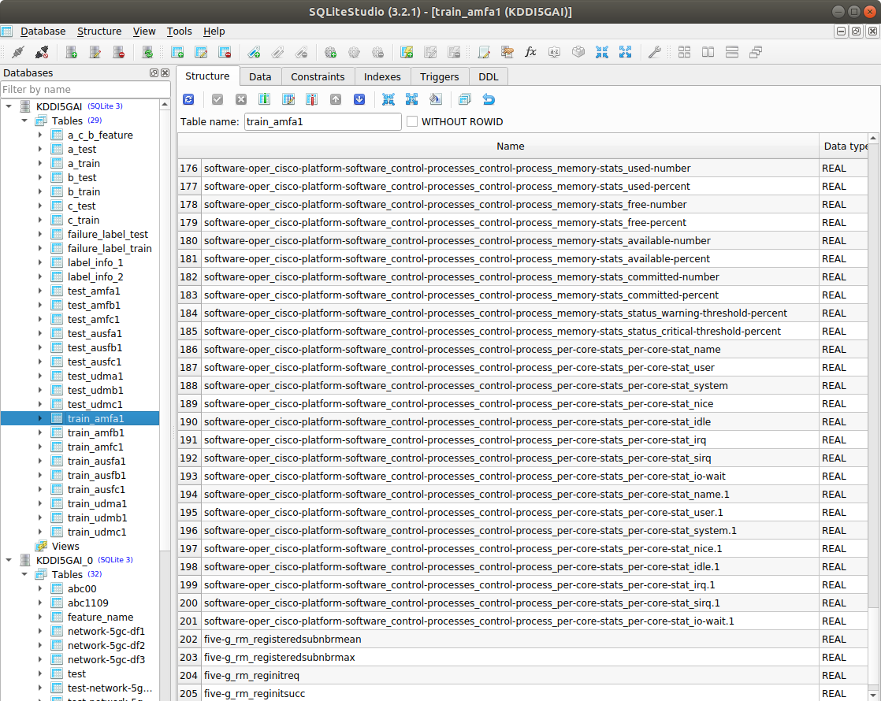
Feature Profile 1 （features name）

Slide 12
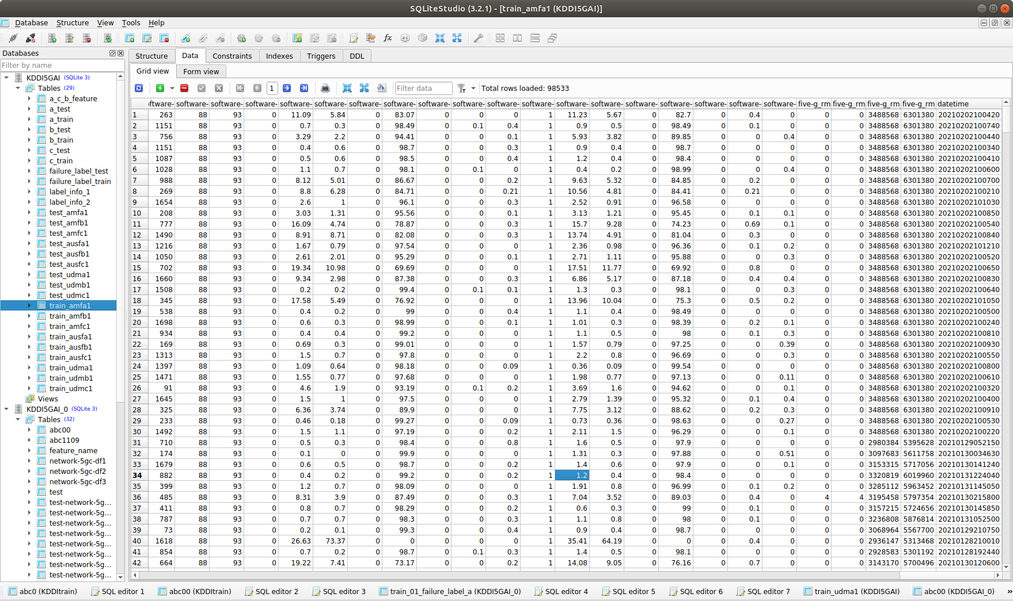
Feature Profile (2)(values)

Slide 13
Machine Learning by Xgboost 2-class model
課程#1
Training by a (urban)： (Normal: 292,306; Abnormal: 3,293)
Test by c (rural)： (Normal: 73,082; Abnormal: 807)
Best score
Precision
Recall
F-1
Confusion Matrix
73,082
0(FP)
Xgboost
100%
100%
100%
0
807(TP)
Training by c (rural)： (Normal:292,395; Abnormal: 3,204)
Test by a (urban)： (Normal: 72,534; Abnormal: 1,352)
Best score
Precision
Recall
F-1
Confusion Matrix
72,534
0(FP)
Xgboost
100%
100%
100%
0
1,352(TP)

Slide 14
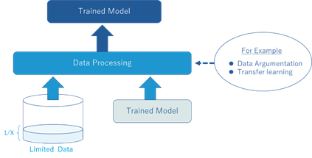
Increment Learning by data agumentation Ⅰ in XGB model
課程#2
Training by agumentation data b (middle)
Trained model by a (urban)
◆ Trained model by a (urban) (Normal: 292,306; Abnormal: 3,293) + Training by b (middle)(Nomal:36,668; Abnormal: 412)
■ Test by b (middle)： (Normal: 73,129; Abnormal: 812)
Precision
Recall
F-1
Confusion Matrix
73,129
0(FP)
Xgboost
100%
83%
91%
135
677(TP)

Slide 15
Increment Learning by data agumentation Ⅰ in XGB model
課程#2
Training by agumentation data b (middle)
Trained model by c (urban)
◆ Trained model by c (urban) (Normal: 292,306; Abnormal: 3,293) + Training by b (middle)(Nomal:36,668; Abnormal: 412)
■ Test by b (middle)： (Normal: 73,129; Abnormal: 812)
Precision
Recall
F-1
Confusion Matrix
73,005
124(FP)
Xgboost
87%
100%
93%
0
812(TP)

Slide 16
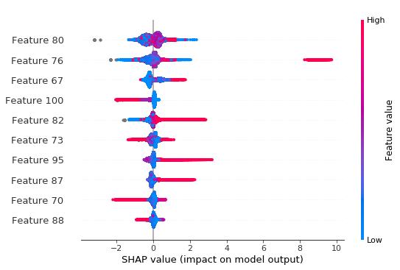
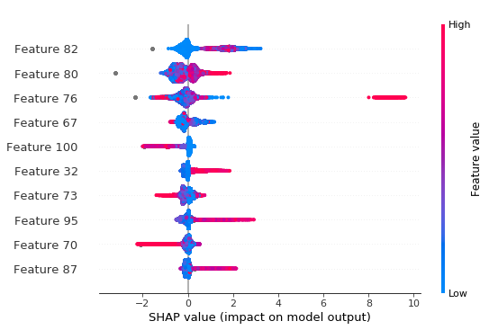
SHAP for Feature analysis (1)
障害原因分析
SHAPとはブラックボックスしがちな予測モデルの各変数の寄与率を求めるための手法で，各特徴量が予測モデルの結果に対して正負のどちらの方向に対してどれくらい寄与したかを把握することによって予測モデルの解釈を行えるようになります． SHAPの理論は主に協力ゲーム理論におけるShaply Valueが由来となっており，協力ゲーム理論におけるプレイヤーを特徴量に置き換えて特徴量毎の貢献度(Shapley Value)を求めています
Train in Rural (c)
Test in Urban (a)
The data distribution is different in rural (train)（ and urban (test) area, so that the features contributions (shap value) to detect abnormal are somewhat different.

Slide 17
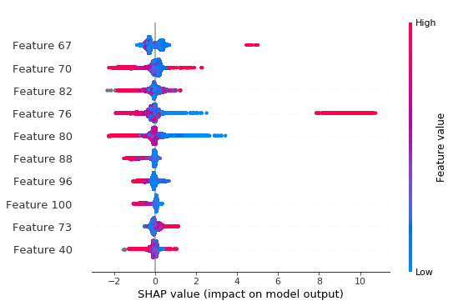
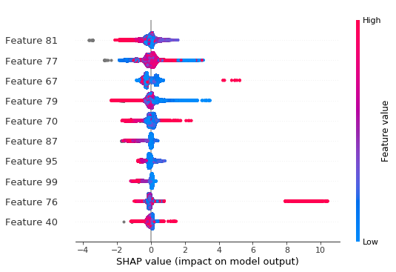
SHAP for Feature analysis (2)
障害原因分析
Train in urban (a)
Test in Rural (c)

Slide 18
Improvement Proposal
改善点など
Feature clustering or mapping is helpful to confirm the feature’s effectiveness
Investigate the influence from different information (CPU load info, traffic info, five-g session info) separately by training 3 AI models respectively.
How to choose features should be investigate more deeply.

